Slide 1
Bulletproof Transient Error Handling with Polly
SPEAKER NAME
Notes:
Abstract:
Connected applications only work when connected. What happens if the network breaks temporarily? Will your system recover smoothly or pitch a fit? Using an OSS project called Polly (available on GitHub) you can handle this and many other transient situations with elegance and fluency. Polly let’s you define resilience and load-handling policies such as retry, wait and retry, circuit breaker, bulkhead isolation and timeouts and more. Learn how to make your system bulletproof with Polly and a little know-how.

Slide 2

Notes:
Story of App vNext.

Slide 3
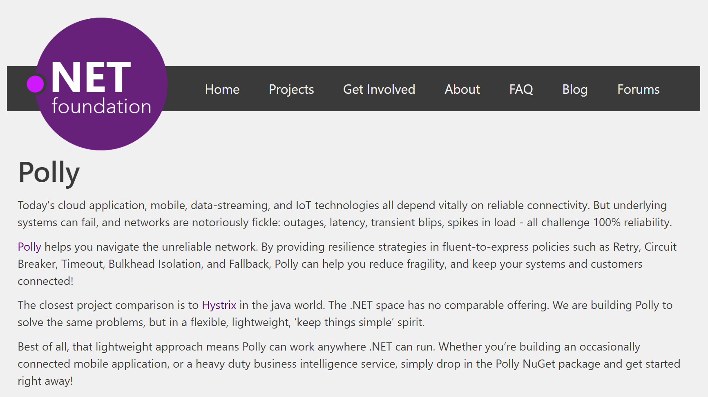
Notes:
Polly was accepted into the .NET Foundation in October, 2016!!

Slide 4
Transient Errors
Network outages
Service outages
Denial of Service attacks
IO locks
Connected device failures

Slide 5
What happens when you flood a struggling service with requests?

Slide 6

Notes:
Ladies throwing chocolates over their shoulders / into mouths = downstream system can’t cope, *dropping requests*

Slide 7

Polly to the rescue!
.NET 4.5+ / .NET Standard 1.1 / .NET Std 2.0+ / .NET Core 2.1+
Fluently express transient exception handling policies:
Retry, Circuit Breaker, Timeout,
Bulkhead Isolation, Fallback
https://github.com/App-vNext/Polly
Nuget: Install-Package Polly

Slide 8
Polly offers multiple resilience strategies ...
Retry … ‘Maybe it’s just a blip’
Circuit Breaker … ‘That system is down / struggling’
Timeout … ‘Don’t wait forever!’
Bulkhead isolation … ‘One fault shouldn’t sink the whole ship’
Cache … ‘You’ve asked that one before!’
Fallback … ‘If all else fails … degrade gracefully’
All policies can be combined, for multiple protection!

Slide 9
History of Polly
2013 Michael Wolfenden invents Polly 2015 Scott Hanselman (Microsoft) recommends Polly! Thoughtworks (Martin Fowler et al) recommend Polly!
Dec 2015 App-vNext take stewardship. Full async support. Apr 2016 Advanced circuit breaker. Jul 2016 Handle return values as faults. Oct 2016 Timeout, Bulkhead Isolation, Fallback, PolicyWrap 2017 Cache, PolicyRegistry, InnerExceptions, RetryAfter, Jitter 2018 Deep integration into .NET Core 2.1, HttpClientFactory 2019 Custom policies, Sourcelink, Simmy (chaos injection)
Notes:
RetryAfter: Honors servers which return 429 status codes (“Retry-After: x milliseconds”), when servers rate-limit consumers.
Jitter: adds some randomisation to retry intervals, so that the retries themselves don’t become spikes in load.

Slide 10
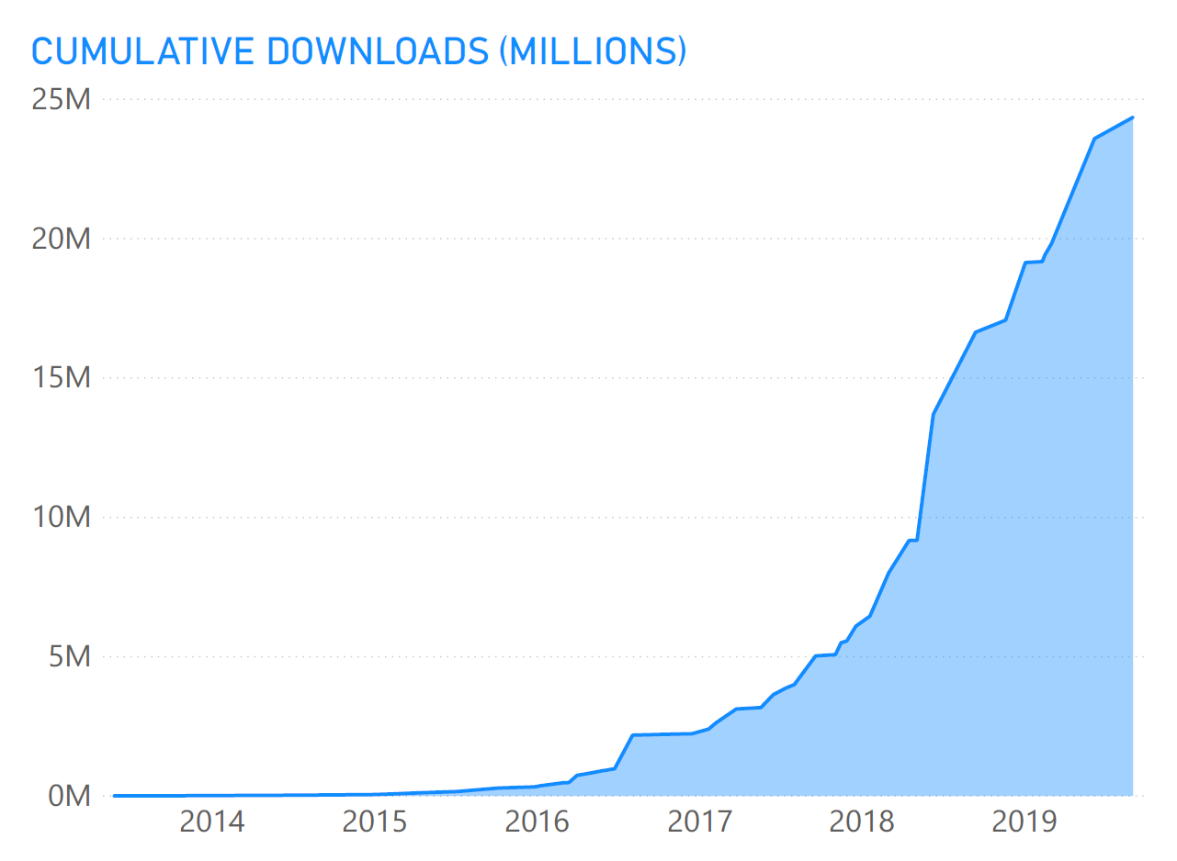
Polly ADOPTION
Polly main package downloads since May, 2013
Cumulative for all Polly packages to date: >29 million
46 releases, 38 since AvN took over in 2015
Notes:
Nov 2019: Running at three million downloads every six weeks (70k per day)

Slide 11
Step 1: Define Policy
var retryPolicy = Policy
.Handle<EndpointNotFoundException>()
.RetryForeverAsync();

Slide 12
Step 2: Execute with Policy
var response =
await retryPolicy.ExecuteAsync(() => DoSomething());

Slide 13
Retry Patterns
Retry immediately on failure. Specify number of retries.
Wait and Retry Retry with a timeout in between each try. Change the timeout between each retry, eg exponential back-off, jitter.
Retry Forever Keep retrying until succeeds.
Retry addresses ... ‘It’s probably a blip. Give it another go - it might succeed.’

Slide 14
Circuit Breaker
Circuit Breaker Breaks the circuit for a configured period if too many errors occur
Blocks calls while circuit is broken.
Protects downstream system - chance to recover.
Fail fast to the caller to prevent cascading effects.
Circuit Breaker addresses … ‘Whoa, that system is struggling / down. Give it a break. And don’t hang around waiting for an answer that’s unlikely right now!’
Notes:
Circuit-Breaker: = The ladies in the video (= downstream system) are having a meltdown: so give them a break.
Stop sending chocolates down the line for a while, so they can recover (and if the calls/chocolates are only going to be dropped anyway, why send ‘em? Fail fast instead - don’t try calls which are unlikely to succeed!)
So: Fail fast = better user experience, if the call is likely to fail anyway.
*Original Circuit-Breaker*, trigger to break = too many chocolates in a row get dropped.
*Advanced Circuit-Breaker*, trigger to break = too high proportion of chocolates get dropped.

Slide 15
Timeout
Timeout Stop waiting once you think an answer will not come
Optimistic mode Co-operative timeout via CancellationToken
Pessimistic mode Enforces timeout (returns to caller) even when governed delegate doesn’t support timeouts/cancellation. Timeout ensures … callers can ‘walk away’ from a faulting downstream system, release blocked threads/connections etc.

Slide 16
Bulkhead Isolation
Bulkhead Prevents one operation from consuming more than its fair share of resources.
Imagine one stream of calls starts faulting slowly...
All threads in a caller could end up waiting on that system … until it starves the caller doing anything else.
Bulkhead prevents this, by limiting the resources (threads etc) a given call stream can consume.
Bulkhead … ‘One fault shouldn’t sink the whole ship!’
Notes:
Source of bulkhead idea: Large ocean vessels are divided (inside the hull) into separate bulkheads. These can be sealed off (from one another). Idea: if ship damaged, only one bulkhead floods (each sealed off). One fault doesn’t sink the whole ship!
Related software principle: Limit the resources consumable by different operations, so that one faulting stream of calls can’t ‘sink’ the whole system.
Implementation = a simple parallelism throttle (SemaphoreSlim).
Analogy: Supermarkets reserve separate groups of check-outs for “shopping carts” versus “baskets only” or “12 items or fewer”. This is bulkhead isolation. If they didn’t isolate different streams (if was all mixed), and there was a glut of large shopping carts going through, the large carts would flood all checkout aisles, use all capacity; this would prevent people with only small baskets also checking out quickly. By reserving some aisles for “baskets only”, those people with baskets-only can always checkout quick. Bulkhead isolation = separate defined capacity for different operations.
( Alternative similar analogy: airline check-in. There’s always a reserved check-in queue (reserved capacity) for first-class check-in. )
Analogy: think of those full shopping carts as slow-responding / heavy-payload / faulty endpoints on your service. Do you want those faulting calls to have the potential to gobble all resource, and also stop the other endpoints responding?
Bulkhead also = pro-active load-shedder. Intentionally sheds load, when parallelism exceeded.
Why pro-actively shed load? (in advance of the server/service’s maximum capacity)
Because failing predictably (in a managed/controlled fashion) is better than failing in unpredictable or unexpected ways.
Analogy: humans drinking. Not having pro-active load management is like someone saying they know when they’ve drunk too much because they pass out or start behaving chaotically. Do you want to leave your servers unbounded, to “drink so many requests” that they start behaving chaotically or keel over? No? So: think about pro-active load-shedding.
Best: monitor bulkhead capacity; use full/near-full bulkhead as trigger for horizontal scaling.

Slide 17
Read-through Cache
Cache A certain proportion of calls will be duplicates. Serve from cache if you can - reduce latency and save calls.
Pluggable interface – simple to add any cache provider you like
Eg MemoryCache, Redis, Amazon ElastiCache, etc
Extension point for serialization/deserialization
Cache addresses … ‘You’ve asked that one before!’

Slide 18
Fallback
Fallback Specifies a substitute value to provide (or action to run) when an operation still fails.
Fallback addresses … ‘Failures will occur … prepare how you will respond when that happens’

Slide 19
Policy Wrap
PolicyWrap Combine any of the previous strategies into one concise policy.
PolicyWrap myResilience =
Policy.Wrap(fallback, retry, breaker, timeout);
myResilience.Execute(() => DoSomething());

Slide 20
Policy Basics
Define how transient exceptions should be handled
Fluent and concise
Thread-safe
Reusable across call sites
Sync or async
Chain policies together
Apply to any Action or Func (service calls, data stores, web requests, mobile connectivity)
Notes:
All these resilience patterns are brilliantly covered in Michael Nygard’s book Release It!

Slide 21
Demos
https://github.com/App-vNext/Polly-Samples

Slide 22
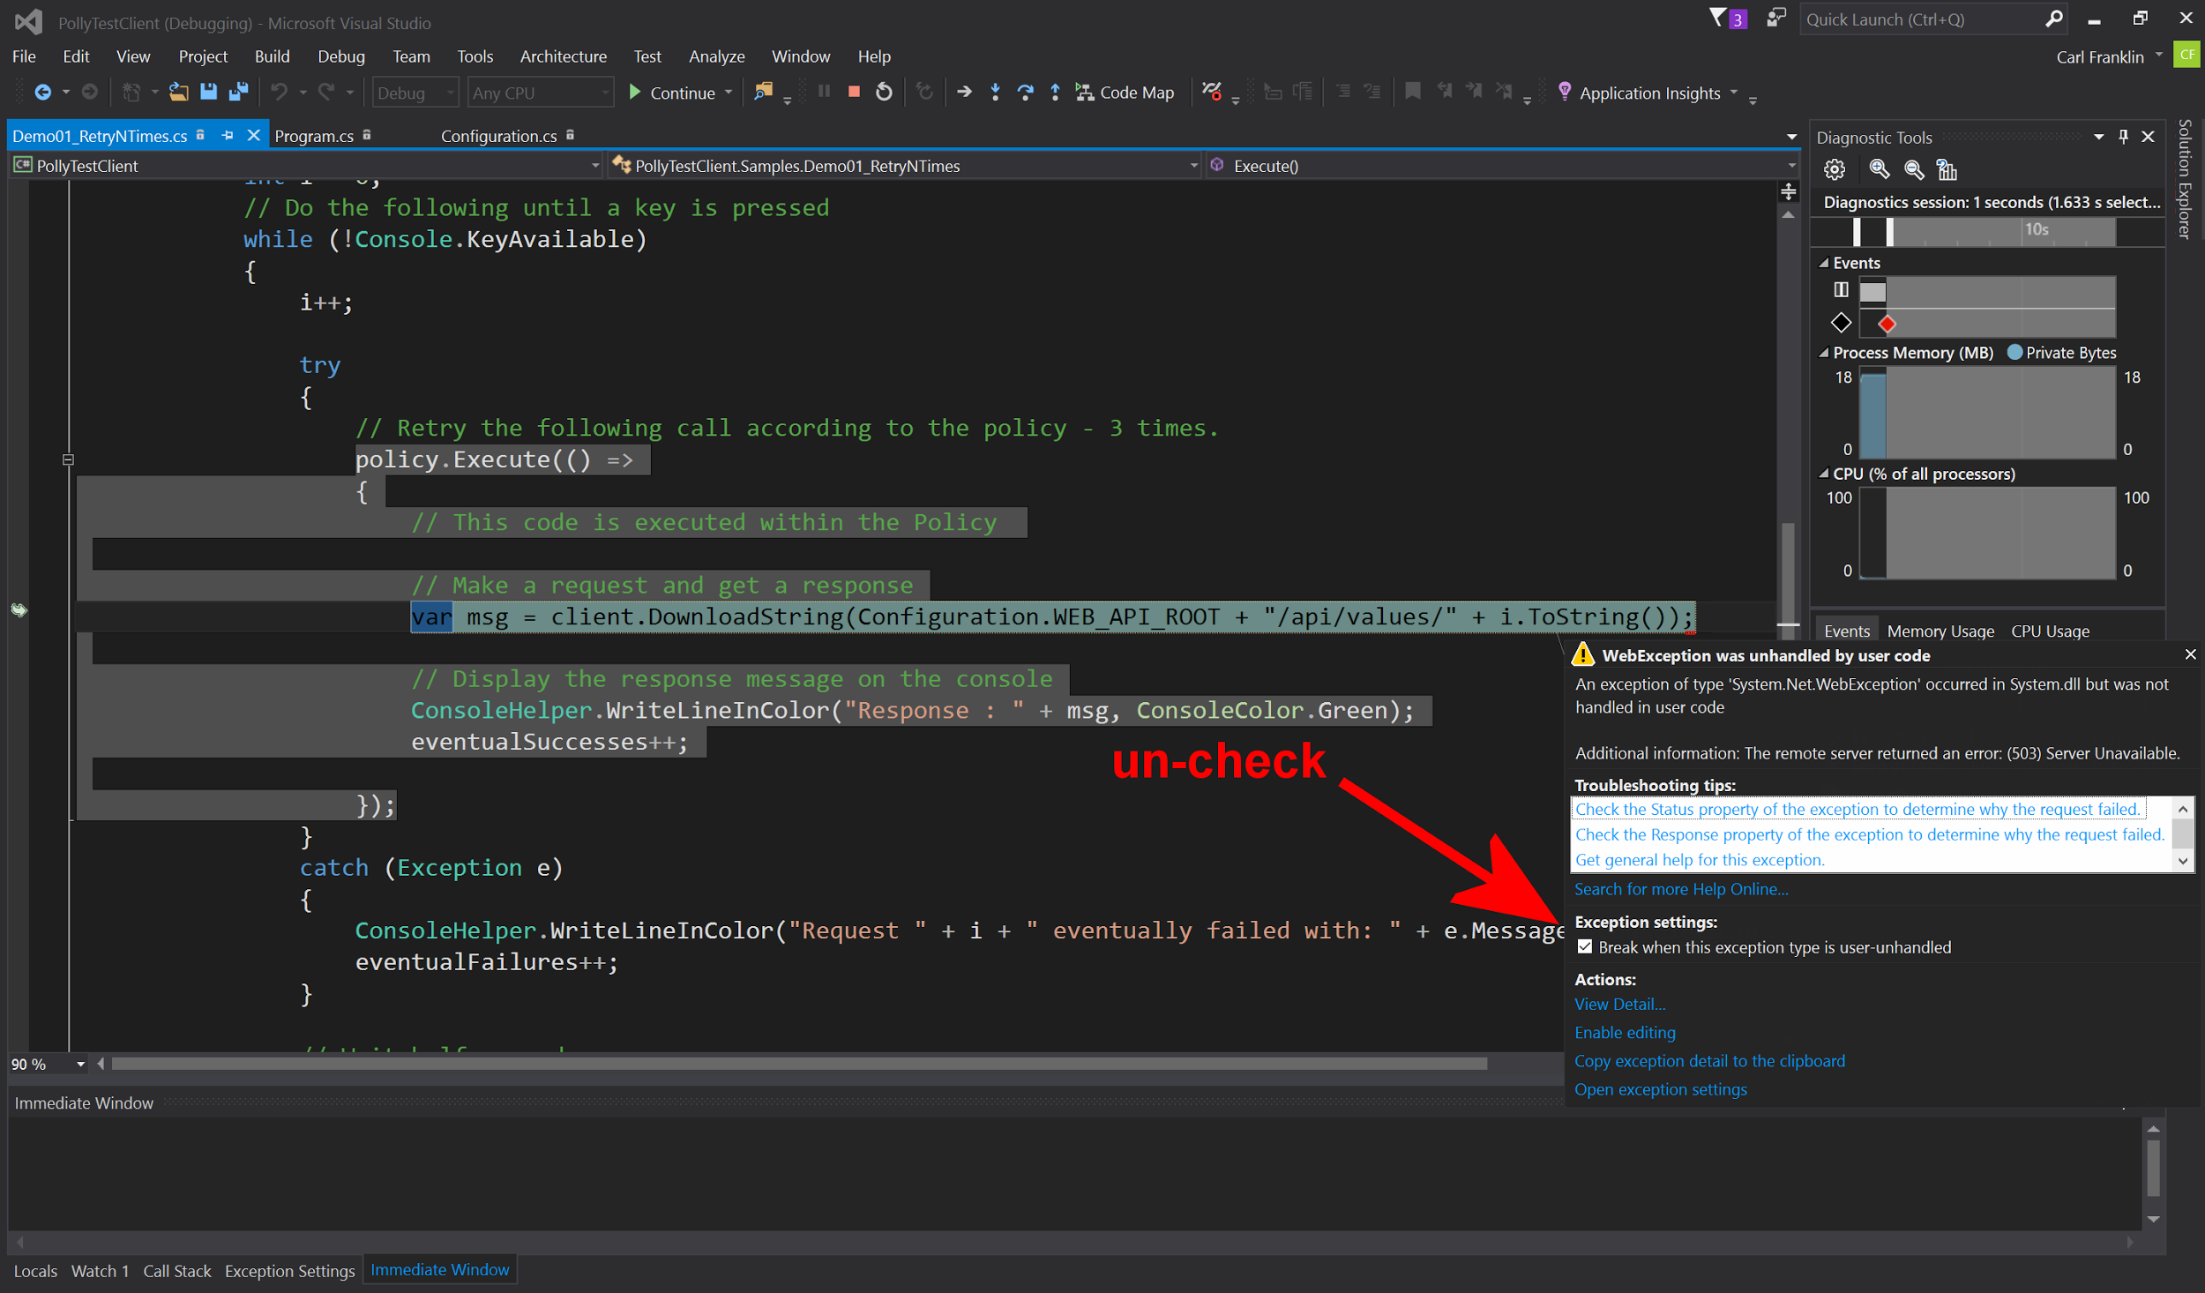
Notes:
Uncheck this tickbox if demoing the Samples out of Visual Studio simply by pressing F5 for Debug. Or ctrl-F5 for start-without-debug.

Slide 23
Further features
Handle multiple exception types in one policy; filter exceptions handled:
var policy = Policy .Handle<SqlException>(ex => ex.Number == 1205) .Or<TimeoutException>() .RetryAsync(3);
Register delegates (onRetry, onBreak etc) to capture policy events, eg for logging.

Slide 24
Further features
Handle both exceptions and return values within the same policy.
Ideal for HttpClient:
var httpPolicy = Policy .Handle<HttpRequestException>() .OrResult<HttpResponseMessage>(r => r.StatusCode == HttpStatusCode.InternalServerError) .RetryAsync(3);

Slide 25
Further features
Handle inner exceptions natively.
Useful where root cause exceptions can get wrapped in AggregateException:
var httpPolicy = Policy .Handle<HttpRequestException>() .OrInner<OperationCanceledException>() .RetryAsync(3);

Slide 26
Further features
PolicyRegistry: simple key-value store.
+ separate policy config (at startup) from usage
+ promotes DI: inject the registry to controllers, services
+ dynamically update policies in the registry, for dynamic reconfiguration during running. Tweak timeouts, circuit-breaker sensitivity etc in production.
Notes:
Bullet 3 – Dynamic Reconfiguration:
In some applications, it can be useful to be able to reconfigure policies dynamically without restarting the process.
Eg You might want to tweak circuit-breaking thresholds to be more or less sensitive according to conditions in production.
With PolicyRegistry, you simply replace the policy in the registry with a new one, when the underlying configuration source is detected to have changed.
More at: https://github.com/App-vNext/Polly/wiki/Dynamic-reconfiguration-during-running

Slide 27
INTEGRATION WITH .NET CORE >= 2.1
Deep integration with HttpClientFactory.
Configure HttpClient variants for DI at startup:
services.AddHttpClient("GitHub", client => { client.BaseAddress = new Uri("https://api.github.com/") }) .AddTransientHttpErrorPolicy(p => p.WaitAndRetryAsync(3));
All calls through that client will use the config’d policies.
Configured client can be DI-injected anywhere in app.
Notes:
Notes on HttpClientFactory: (beyond Polly)
Part of .NET Core 2.1. Usable in ASP.NET Core or in .NET Core microservice apps.
Fluent syntax for configuring HttpClient instances with Polly policies governing calls
Provides a central location for naming and configuring logical HttpClients. For example, you may configure a client that is pre-configured to access the github API.
Manages the lifecycle of HttpClient instances – deals with earlier confusion about how frequently to recycle/dispose HttpClient instances, for performance and to capture DNS changes
Polly wiki has full details. Scott Hanselman and Steve Gordon have written excellent blog posts.

Slide 28
SIMMY – CHAOS ENGINEERING with Polly
Selectively inject failures in prod/pre-prod.
var chaosPolicy = Policy.InjectFault<SocketException>( faultRate: 0.005, // fail randomly 0.5% of the time enabled: () => isEnabled() // Func<bool>, can toggle on/off );
Embed chaos-injection policies into prod/any environment.
Turn chaos experiments on/off easily by config.
Vary fault rates to explore system resilience.
Notes:
Feature PR complete – releases in next few weeks.
Final syntax TBC.
Details via Polly website.

Slide 29
SIMMY – CHAOS ENGINEERING with Polly
Selectively inject latency in prod/pre-prod.
var chaosPolicy = Policy.InjectLatency( latency: TimeSpan.FromSeconds(2), // or randomized faultRate: 0.02, // add latency 2% of the time enabled: () => isEnabled() // Func<bool>, can toggle on/off );
Embed chaos-injection policies into deployments.
Low overhead: ~1 microsecond (1/millionth sec) when off.
Notes:
Feature PR complete – releases in next few weeks.
Final syntax TBC.
Details via Polly website.

Slide 30
SIMMY – FAKE FAILURES FOR TESTS
Unit testing your services - easily fake results for any execution guarded by Polly.
var failure = Policy.InjectResult<HttpResponseMessage> (new HttpResponseMessage(HttpStatusCode.RequestTimeout));
Pass the failure policy into your component-under-test by DI.
Unit-test how your services/outbound calls handle failures.
Notes:
Feature PR complete – releases in next few weeks.
Final syntax TBC.
Details via Polly website.

Slide 31
SIMMY – CHAOS ENGINEERING with POLLY
Fully configurable
+ all fault types configurable with dynamic Funcs
+ contextual: inject faults only on specific call paths
Released June 2019 – follow Polly on twitter/slack for more!
https://github.com/Polly-Contrib/Simmy

Slide 32
Distributed Circuit Breaker
Distributed circuit-breaker backed by a state store (Azure Durable Entity Functions)
Use within Azure Functions
Or consume from anywhere, over https
Stateful and consistent across distributed callers, across function app scale out
https://github.com/Polly-Contrib/ Polly.Contrib.AzureFunctions.CircuitBreaker
Notes:
Serverless functions and Actors are inherently stateless or short-lived. So they can’t maintain circuit stats (“how many calls have failed?”) across calls. And they often exist in multiple instances horizontally scaled. So they need to store and track the circuit state externally.

Slide 33
Options for other languages/platforms?
Javascript: polly-js
Strategies: retry, retry and wait
Repo: https://github.com/mauricedb/polly-js
Java/Scala: Hystrix (by Netflix)
Strategies: circuit breaker, fallback, bulkhead isolation
Repo: https://github.com/Netflix/Hystrix
Notes:
The polly-js library is based on the Polly .NET library, offering a small subset of capability through retry and retry/wait policies.
Hystrix is a robust reslilience framework by Netflix, but is no longer in development as of early 2018 when Netflix decided to end active development. The original engineers moved on. Hopefully this will be taken up by other contributors.

Slide 34
Options for other languages/platforms?
Javascript polly-js retry example.
polly()
.retry(2)
.executeForPromise(function () {
return requestPromise('http://www.google.com');
})
.then(function(result) {
console.log(result)
}, function(err) {
console.error('Failed trying three times', err)
});
Notes:
Feature PR complete – releases in next few weeks.
Final syntax TBC.
Details via Polly website.

Slide 35
Options for other languages/platforms?
Java Hystrix circuit breaker with fallback example.
import com.netflix.hystrix.contrib.javanica.annotation.HystrixCommand;
...
@HystrixCommand(fallbackMethod = "reliable")
public String readingList() {
URI uri = URI.create("http://localhost:8090/recommended");
return this.restTemplate.getForObject(uri, String.class);
}
public String reliable() {
return "Cloud Native Java (O'Reilly)";
}
}
Notes:
Feature PR complete – releases in next few weeks.
Final syntax TBC.
Details via Polly website.

Slide 36
Polly Wiki
Future Roadmap
Extended documentation
Configuration recommendations
Patterns
Unit-testing strategies
https://github.com/App-vNext/Polly/wiki

Slide 37
Polly Slack channel and Blog
http://www.pollytalk.org/ (slack)
Ask questions
Discuss the roadmap
http://www.thepollyproject.org/ (blog)
Project updates, the inside track

Slide 38
App vNext Polly team
Carl Franklin .NET Rocks, Music to Code By
Dylan Reisenberger .NET enterprise architect, special interest in microservices, messaging, cloud, resilience.
Joel Hulen Enterprise software and cloud architect
… and all you folks who want to make open-source contributions …
https://github.com/App-vNext/Polly/

Slide 39
THANK YOU!
Notes:
Abstract:
Connected applications only work when connected. What happens if the network breaks temporarily? Will your system recover smoothly or pitch a fit? Using an OSS project called Polly (available on GitHub) you can handle this and many other transient situations with elegance and fluency. Polly let’s you define resilience and load-handling policies such as retry, wait and retry, circuit breaker, bulkhead isolation and timeouts and more. Learn how to make your system bulletproof with Polly and a little know-how.

